Slide 1

GLOBAL INSTITUTE OF TECHNOLOGY AND
MANAGEMENT
Major Project
on
“AIR MOUSE”
SUBMITTED BY: SUBMITTED TO:
Chetan Kumar (201155) Dr. Jaspal Kumar
Yogita (204008) Prof. (CSE Department)
Trilok Singh (201096)

Slide 2
OBJECTIVE
The aim of this project is to work with Gyro Sensor (mpu 6050) and translate the motion of the mouse into various applications in a virtual interface. It is most intuitive for us to use things based on mouse motions in air, as they form a very basic form of communication and signaling.
The mouse will be a hand mounted device that maps the movement of the user’s hand onto the computer’s mouse pointer, having all the standard functionalities as that of a computer mouse, left, right, middle click and scroll. Unique combination of finger movements that are very similar to the current mouse usage behaviorally would represent each of these.

Slide 3
Introduction
This project will deal with an innovative idea of converting a mouse in to an air mouse. Conventional mouse needs a wire and a surface over which it will be move.
In our project the mouse can be used without surface, when mouse will be tilt in any direction the cursor inside the PC or laptop will move in that direction. Mouse and PC will be connected via Bluetooth.
The Air Mouse project holds immense potential for various applications, including presentation control, media center navigation, gaming, accessibility tools, and more. Its affordability, customizability, and ease of programming make it an attractive choice for DIY enthusiasts, educators, and hobbyists alike.

Slide 4
Working
Hardware Setup: Connect Arduino Leonardo to computer via USB.
Sensor Integration: Add gyroscopes and accelerometers (e.g., MPU6050) for motion detection.
Data Processing: Use Arduino programming to process sensor data for mouse movements.
USB HID Emulation: Employ Arduino's HID capabilities to emulate mouse functions.
Movement Mapping: Translate sensor data into cursor movements and clicks.

Slide 5
Button Controls: Optionally, include buttons for mouse clicks or other actions.
Testing and Calibration: Test mouse for accuracy, calibrate sensors if needed.
Application Integration: Integrate mouse with desired applications on computer.
User Interaction: Control cursor and perform mouse actions by moving the air mouse.
Feedback and Iteration: Gather feedback, iterate design and functionality as necessary.

Slide 6
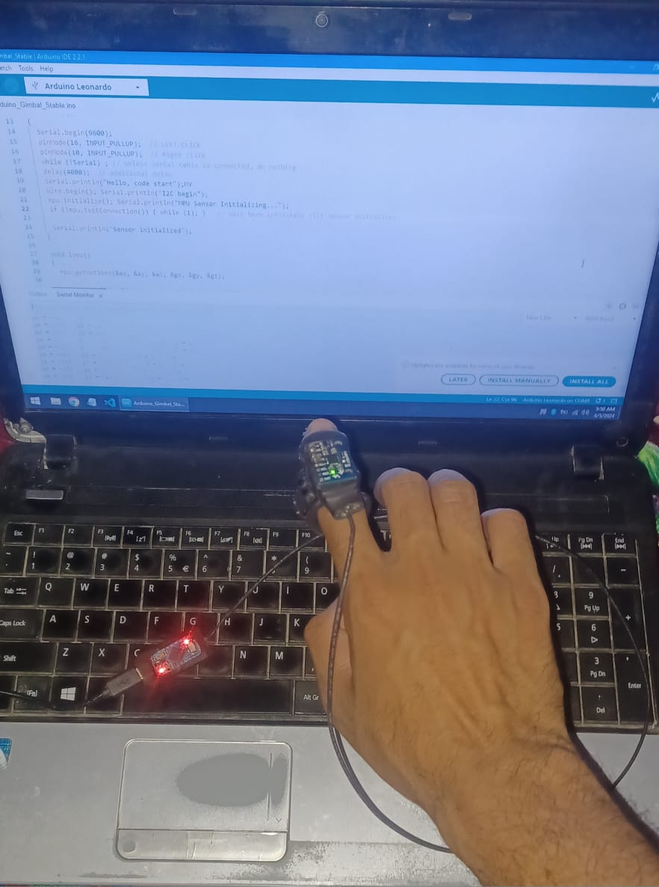
RESULT

Slide 7
Hardware Used
Arduino Leonardo
Inertial Measurement Unit (IMU)
USB Cable
Push Buttons (optional)
Header Pins
Gyro Sensor (mpu 6050)

Slide 8
Software Used
Arduino IDE
Arduino Libraries
Arduino Sketch (Code)
USB HID (Human Interface Device) Library
Serial Communication
Optional Software Tools

Slide 9
Applications
Gaming: The Air Mouse can be used as a controller for gaming applications. It can provide a more immersive gaming experience, especially for motion-controlled games or virtual reality applications.
Presentations: Presenters can use the Air Mouse to control slides during presentations. It offers more freedom of movement compared to traditional remote controls, allowing presenters to navigate through slides while moving around the stage.

Slide 10
Advantages
Flexibility: Arduino Leonardo boards can be easily programmed using the Arduino IDE, allowing users to implement various functionalities beyond basic mouse control. This flexibility enables the creation of diverse applications.
Ease of Programming: Arduino's simple programming language and extensive documentation make it accessible to beginners and experienced developers alike. Users can quickly learn to program the Arduino Leonardo for their specific project requirements.

Slide 11
limitations
Tethered Operation: The wired connection requires the mouse to be physically connected to the computer via a USB cable. This can restrict movement and may not be suitable for certain applications where freedom of movement is desired.
Potential Cable Interference: The USB cable may get tangled or caught on objects, causing inconvenience or potential damage to the cable or connected devices.
Risk of Cable Damage: Excessive bending, pulling, or strain on the USB cable may result in cable damage or breakage, leading to connectivity issues or the need for cable replacement.

Slide 12
FUTURE SCOPE
Enhanced Sensor Technology: Integration of advanced sensor technologies such as infrared depth sensing or optical tracking for more precise and intuitive motion detection, allowing for finer control and gesture recognition.
Improved Ergonomics and Design: Development of ergonomic designs and lightweight materials for the air mouse enclosure to enhance user comfort and usability over extended periods of use.

Slide 13
THANK YOU

